Slide 1
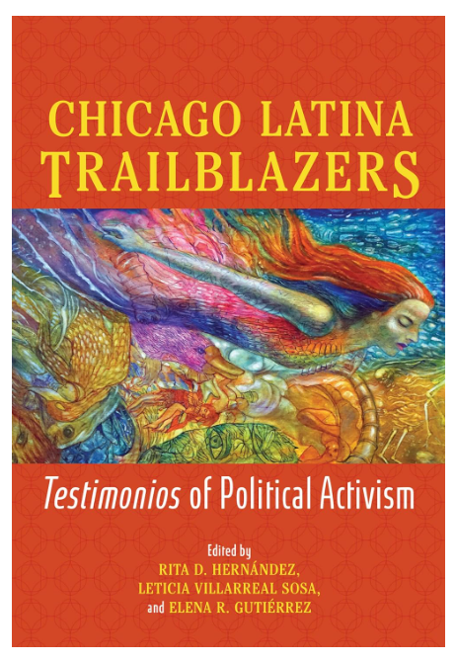
Trailblazer Foundation NFP Request for Funding

Slide 2
Executive Summary
It is both a privilege and honor to present an extraordinary opportunity to partner with us for creating a long-lasting transformational impact for our youth. Our team has spent years developing, writing and publishing a powerful book that amplifies the voices and stories of Latina leaders which will enrich students of all backgrounds. Now, we are ready to bring this book to thousands of students to inspire them to see greatness in themselves just as the authors have showcased in their own journeys!
Who are we: We are a local Non-For-Profit Organization (Trailblazer Foundation, a 501(c)(3) NFP) dedicated to empowering students through education, leadership development and storytelling. We are committed to delivering high-impact programming in partnership with several Chicago Public High schools. Our efforts and goals are part of a larger movement in Illinois that aims to empower all students through learning about our Latino communities for preparation to positively impact current and future generations.
What we want to do: We seek to design and launch a curriculum centered on our recently published book - Chicago Latina Trailblazers: Testimonios of Political Activism - and provide copies of this book directly to the schools. The book’s lead editor and author is our organization’s founder, Dr. Rita D. Hernandez.
Value added: This program is designed to ignite student achievement through reading and meaningful engagement. Students will not only develop literacy skills, they will also learn and put in action the great messages the book provides on drive, discipline, culture and taking the initiative for greatness. These values and traits will continue to grow our Hispanic/Latina/o/x and other minority communities in many ways.
How we want to do it: We are fortunate that we have already secured five Chicago high schools to implement such a program in the upcoming Fall 2026 school year! With school timelines approaching and book orders needed in advance, timely funding is critical to ensure the curriculum and materials are delivered on schedule.
The ask: To bring this initiative to life, our Foundation is a seeking a grant of $210,000 to cover curriculum development, book distribution, and program delivery. Detailed budget information is attached. Your support will directly impact thousands of students.

Slide 3
Trailblazer Foundation NFP
MISSION: To Improve Student Achievement Through Reading
Vision: Hold High Expectations in Reading for All Students
GOALS:
To Expand Return on Investment for Trailblazer Foundation
To Influence Reading as a “Key to Success” by Preparing Students for Gainful Employment
To Measure Reading Improvement for Twenty-five percent of Student Population by NAEP (National Assessment in Educational Progress) and PEW Standards, The Nation’s Report Card
To Provide Socio-cultural Relevant Books, which Fuels Their Interest in Reading
To Encourage Reading with Partnerships by Distributing Chicago Latina Trailblazers (the book) as a Tool to Chicago’s Multi-generation Civic Centers, Schools, and Organizations
To Establish Financial Literacy and to Help Students Solve Problems through Reading
To Provide Reading Tools to Access Opportunities for Recognizing Chicago Public Schools as a Clearinghouse for Latino-centric Books
To Provide Reading Access to Critical Thinking Skills, Creativity, Improved English Language Skills, which Lead to gainful employment opportunities plus countless intangible benefits

Slide 4
The Book
Mexican American and Puerto Rican women have long taken up the challenge to improve the lives of Chicagoans in the city’s Latino/a/x communities. Rita D. Hernández, Leticia Villarreal Sosa, and Elena R. Gutiérrez present testimonies by Latina leaders who blazed new trails and shaped Latina Chicago history from the 1960s through today.
Taking a do-it-all attitude, these Mexican and Puerto Rican women advanced agendas, built new infrastructures, revamped institutions, forged alliances, and created essential resources that Latino/a/x communities lacked. They were the first Latinas to hold their post or create the first Latino/a/x institution of its kind. Just as often, early grassroots efforts to address issues affecting themselves, their families, and their neighborhoods grew into larger endeavors. Their experiences ranged from public schools to healthcare to politics to community activism to broadcast media, and each woman’s story shows how her work changed countless lives and still reverberates across the entire city through the infrastructures they created.
An eyewitness view of an unknown history, Chicago Latina Trailblazers reveals the vision and passion that fueled a group of women in the vanguard of reform.
Source: University of Illinois press, 2024.

Slide 5
Our Budget (See ID Gaps)

Slide 6
Contact Information
Dr. Rita D. Hernandez
President
Trailblazer Foundation NFP
hernandez.rita@sbcglobal.net
(773)576-6314
Dr. Ted Rivera
Treasurer
Trailblazer Foundation NFP
tedrivera@hotmail.com
(847)293-4707

